Slide 1

Recycling Classification
by
Keras-Based Computer Vision
Max Page
Liyang Ru
https://hiro-group.ronc.one/img/logo-long-white-text.svg

Slide 2
Introduction: Why/How
Inefficient process of sorting recyclables at campus recycling process center
Create an autonomous program using TensorFlow to save on time and costs
Program requirements
Dynamically ‘see’ individual objects on conveyor belt
Using convolutional layers classify object to be in 1 of 6 categories ~90% accuracy
Physically sort object to its respective bin with sawyer type robot
Implement with Joewie’s gripping program to complete requirement 3
Test program within lab setting and hopefully the recycling plant itself
Introduction | Methods | Evaluation | Method 2 | Evaluation 2 | Conclusion | Future

Slide 3
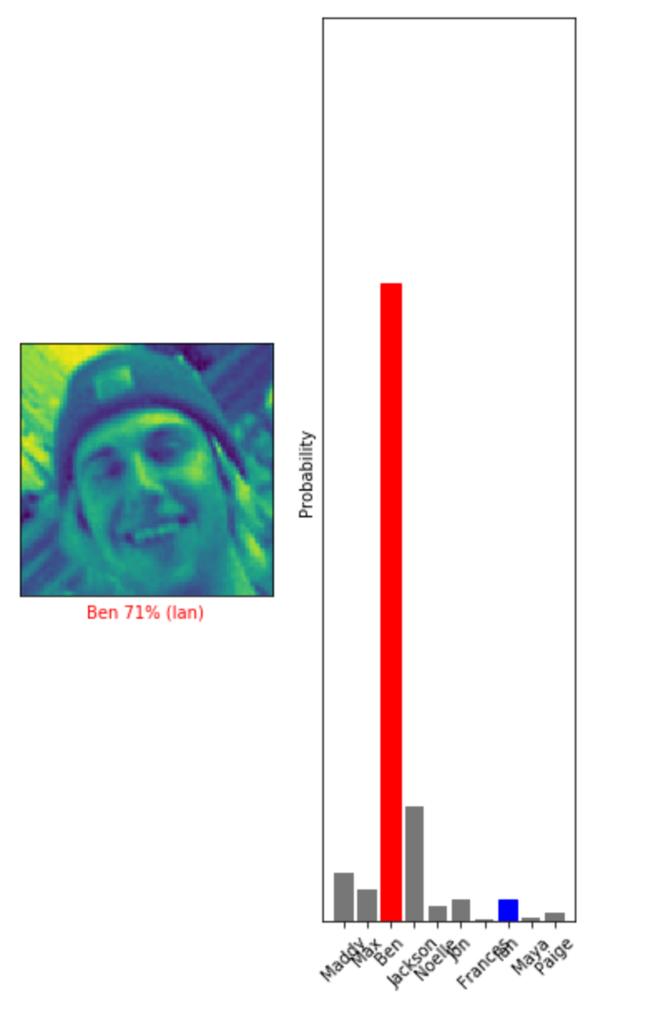
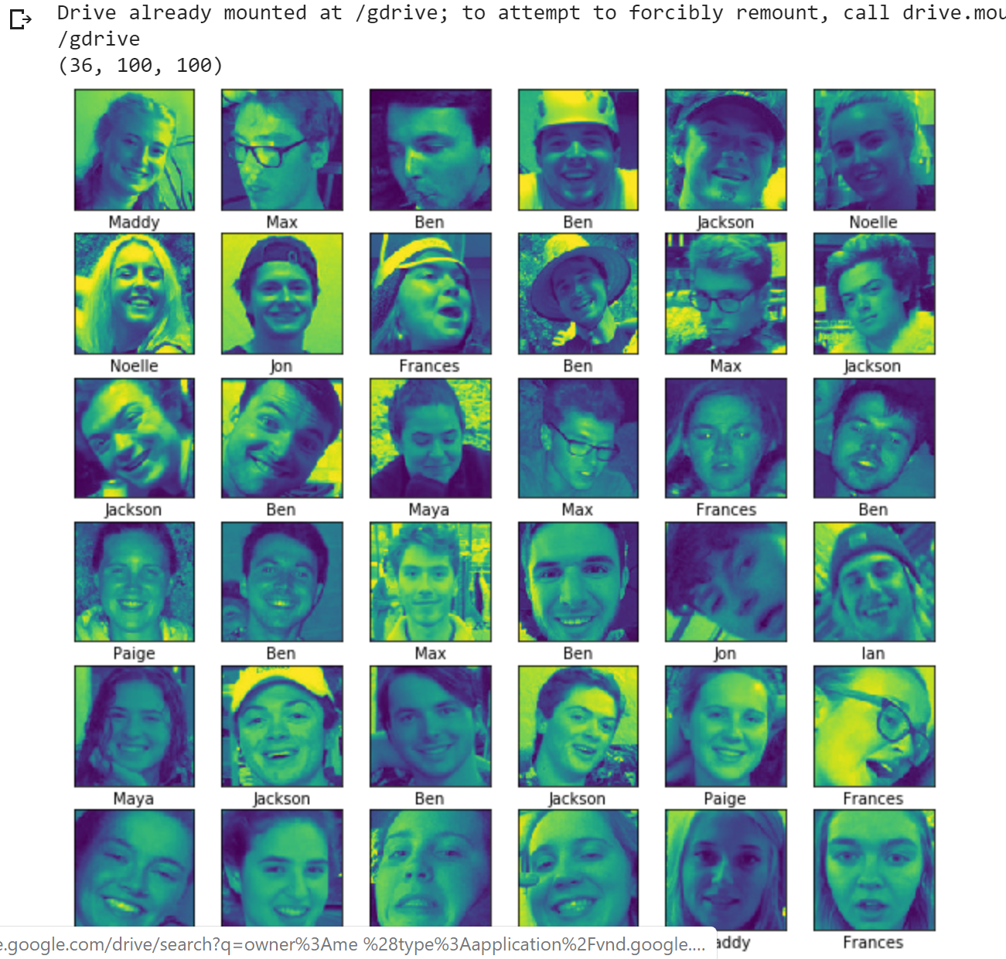
Methods: Trial
Set of 36 images
10 potential solutions
10 epochs
“42%” accuracy
Introduction | Methods | Evaluation | Method 2 | Evaluation 2 | Conclusion | Future

Slide 4
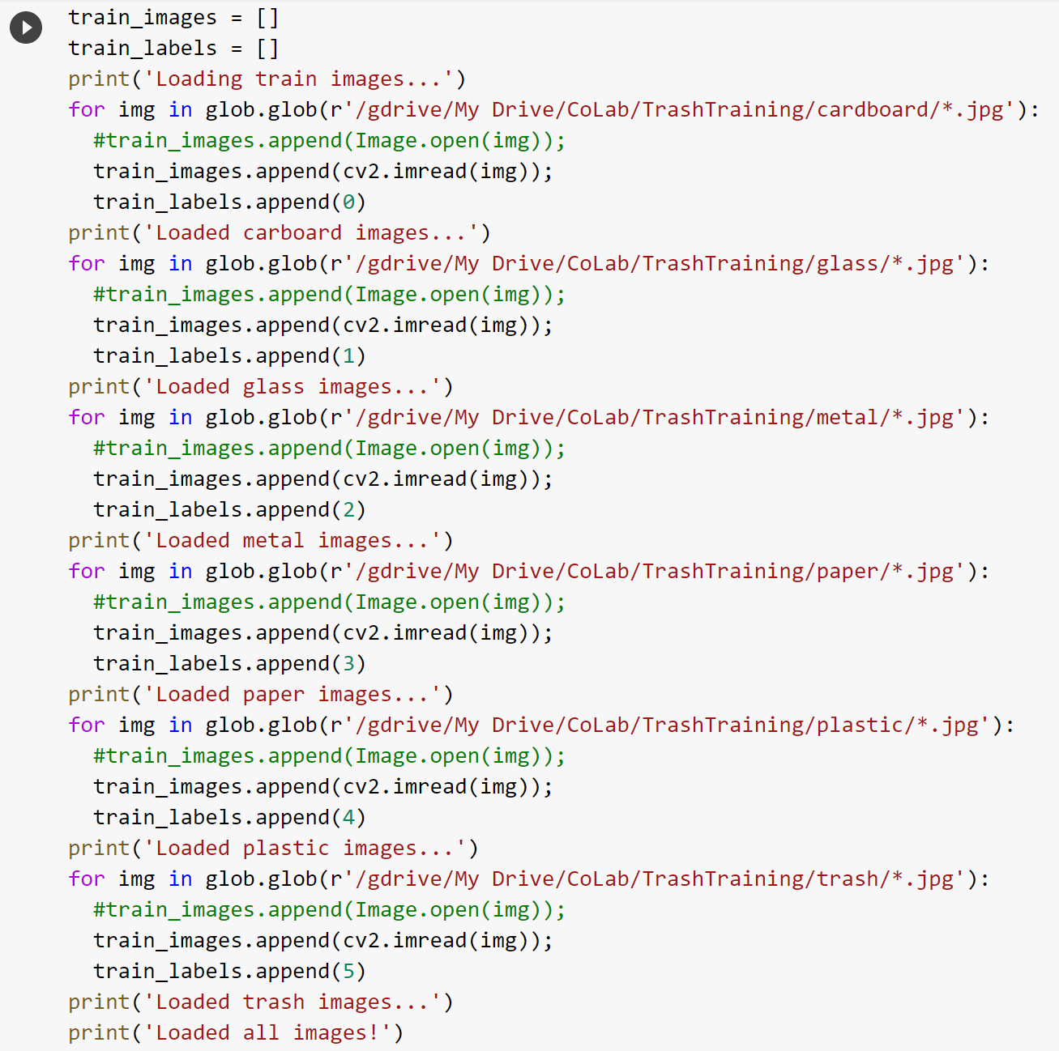
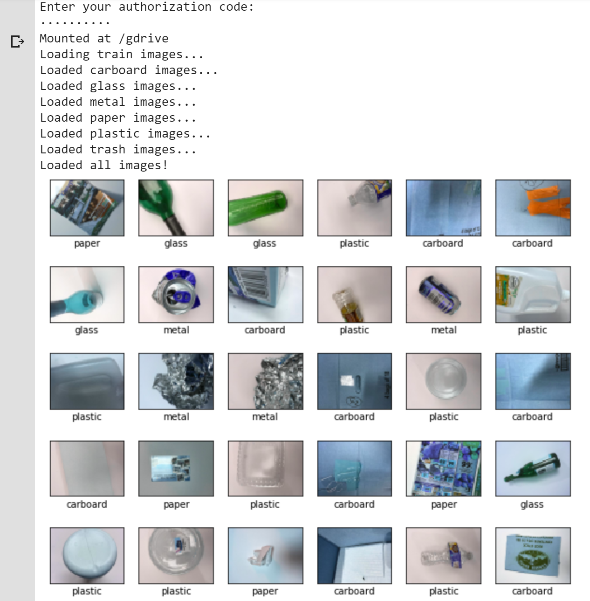
Methods
Introduction | Methods | Evaluation | Method 2 | Evaluation 2 | Conclusion | Future

Slide 5
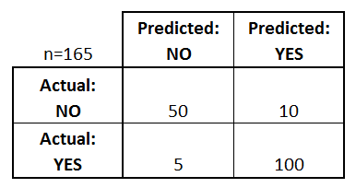
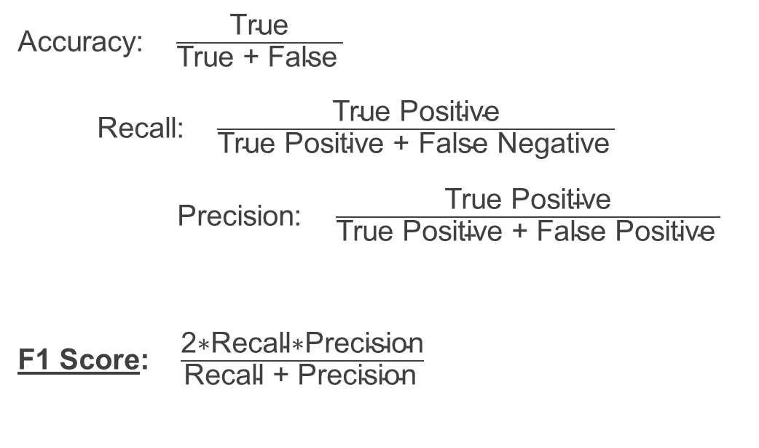
Evaluation: Confusion Matrix
Accuracy: $\frac{\text{T}\text{rue}}{\text{T}\text{rue}\text{ +} \text{False} }$
Recall: $\frac{\text{T}\text{rue} \text{P}\text{ositive}}{\text{T}\text{rue} \text{P}\text{ositive}\text{ + }\text{False} \text{Negative} }$
Precision: $\frac{\text{T}\text{rue} \text{P}\text{ositive}}{\text{T}\text{rue} \text{P}\text{ositive}\text{ + }\text{False} \text{Positive} }$
F1 Score: $\frac{\text{2∗}\text{Recall}\text{∗}\text{Precision}}{\text{Recall}\text{ + }\text{Precision} }$
https://www.dataschool.io/simple-guide-to-confusion-matrix-terminology/
Introduction | Methods | Evaluation | Method 2 | Evaluation 2 | Conclusion | Future

Slide 6
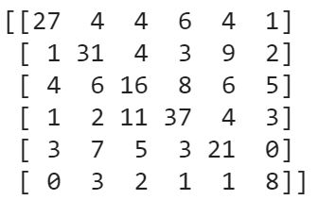
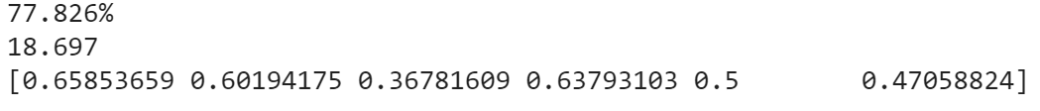
Evaluation: F1 Score
Introduction | Methods | Evaluation | Method 2 | Evaluation 2 | Conclusion | Future
Notes:
Diagonal is correct predictions
77% is mean confidence
18.7 is std of that confidence

Slide 7
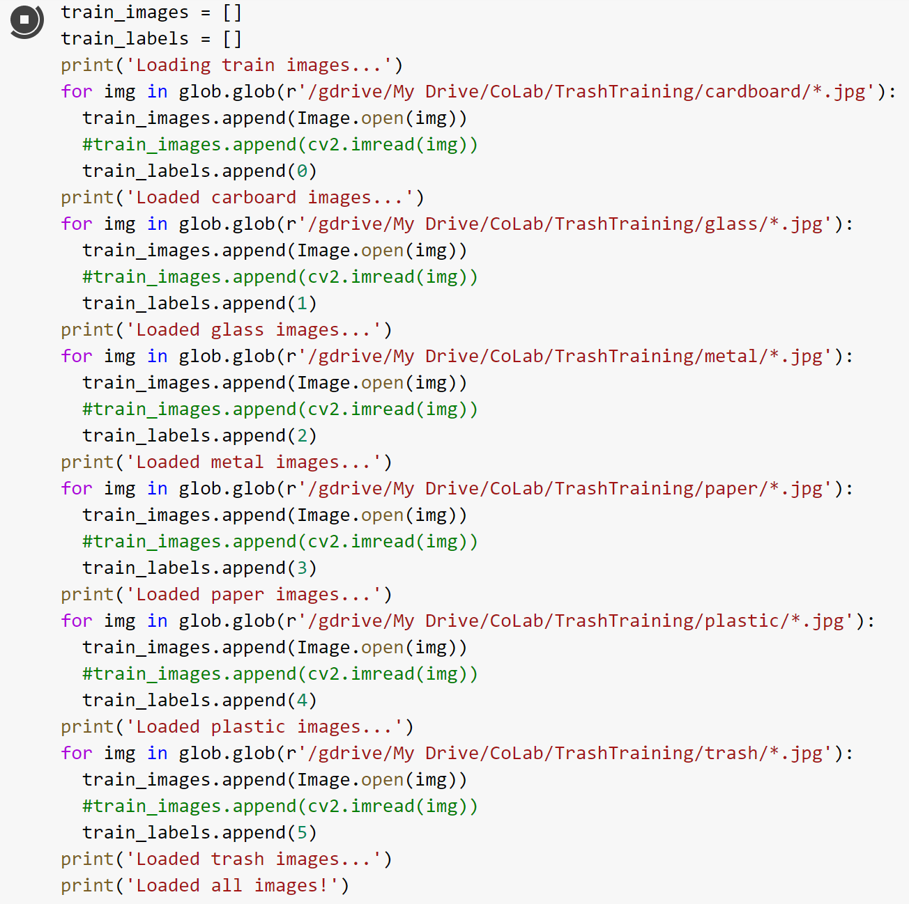
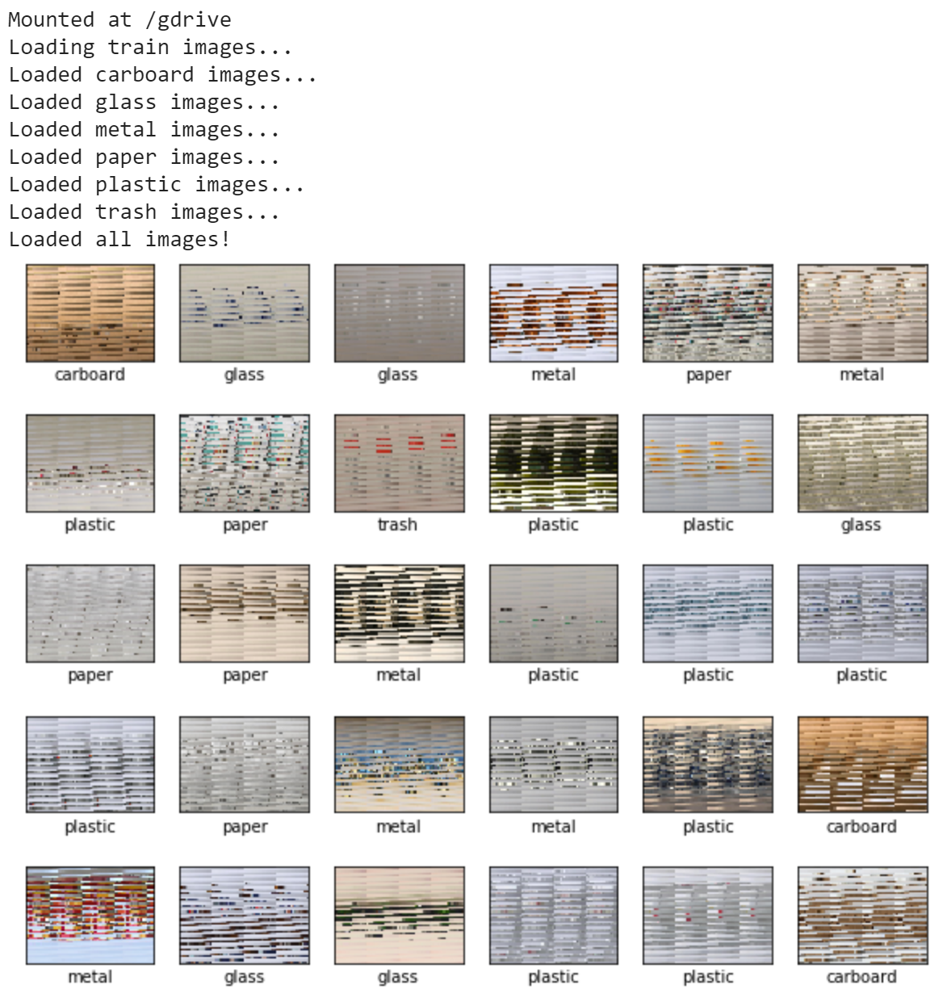
Methods: Area of Interest
Introduction | Methods | Evaluation | Method 2 | Evaluation 2 | Conclusion | Future
Notes:
Image files are (I hesitate to say corrupted) yet they are still unique

Slide 8
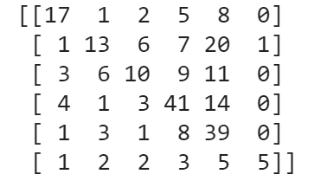
Evaluation: F1 Score
Introduction | Methods | Evaluation | Method 2 | Evaluation 2 | Conclusion | Future
Notes:
Optimized for this method so maybe other method will work better if optimized properly

Slide 9
Takeaways
Moving ahead with second method as it yields better results
Learned how to use machine learning for classification
Learned python and the use of a few associated standard libraries
Learned to operate hardware (intel realsense) remotely using raspberryPi
Excited to move forward in the process and hopefully see the results of a real-world test by end of the semester
Built a great group of peers within the lab
Introduction | Methods | Evaluation | Method 2 | Evaluation 2 | Conclusion | Future
Notes:
Method is fine because it processes the images the same way so the output is still valid

Slide 10
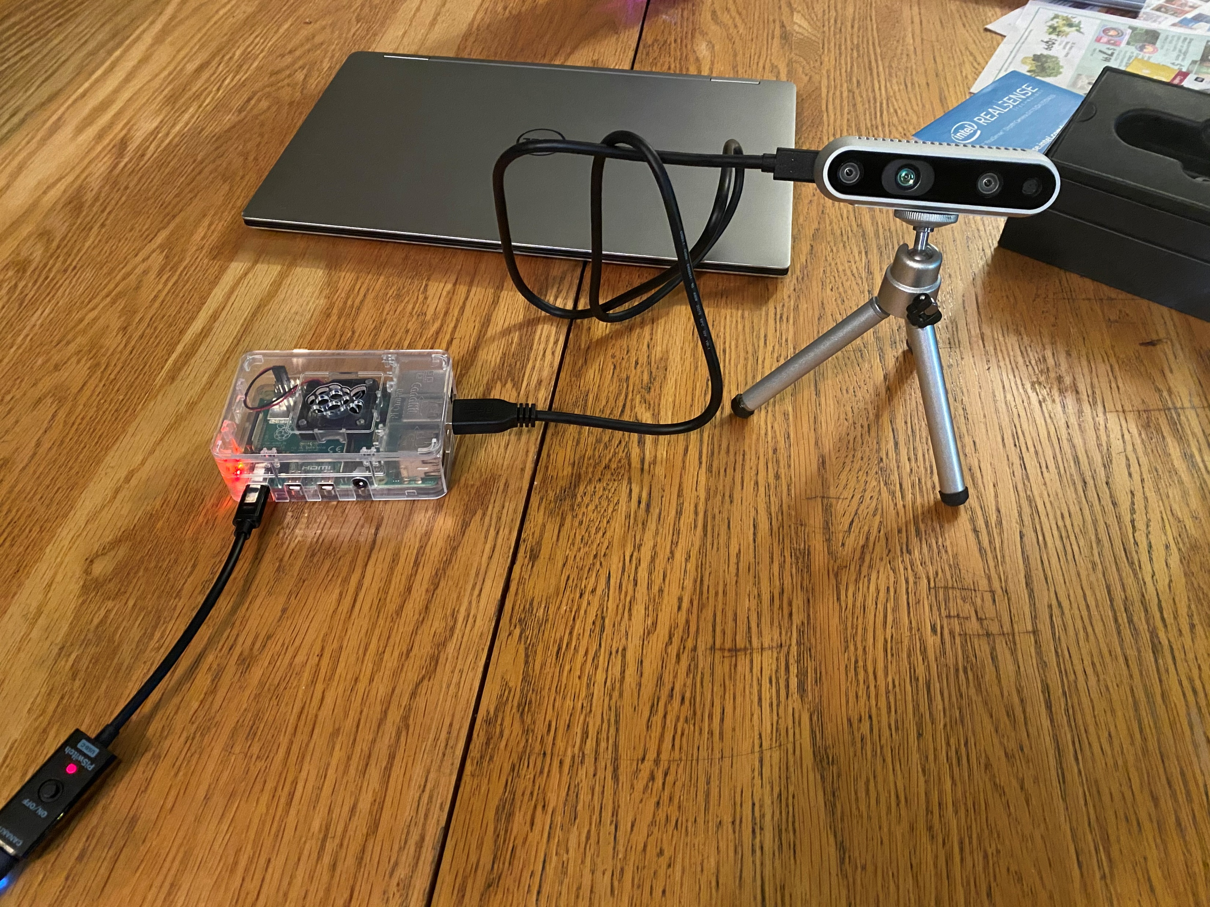
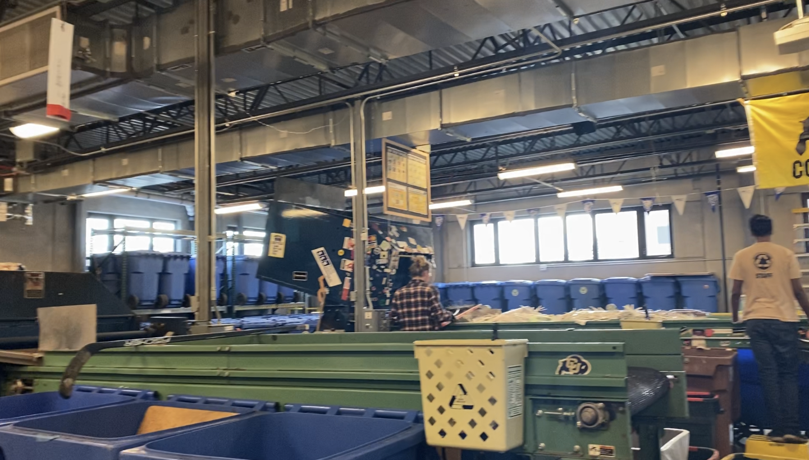
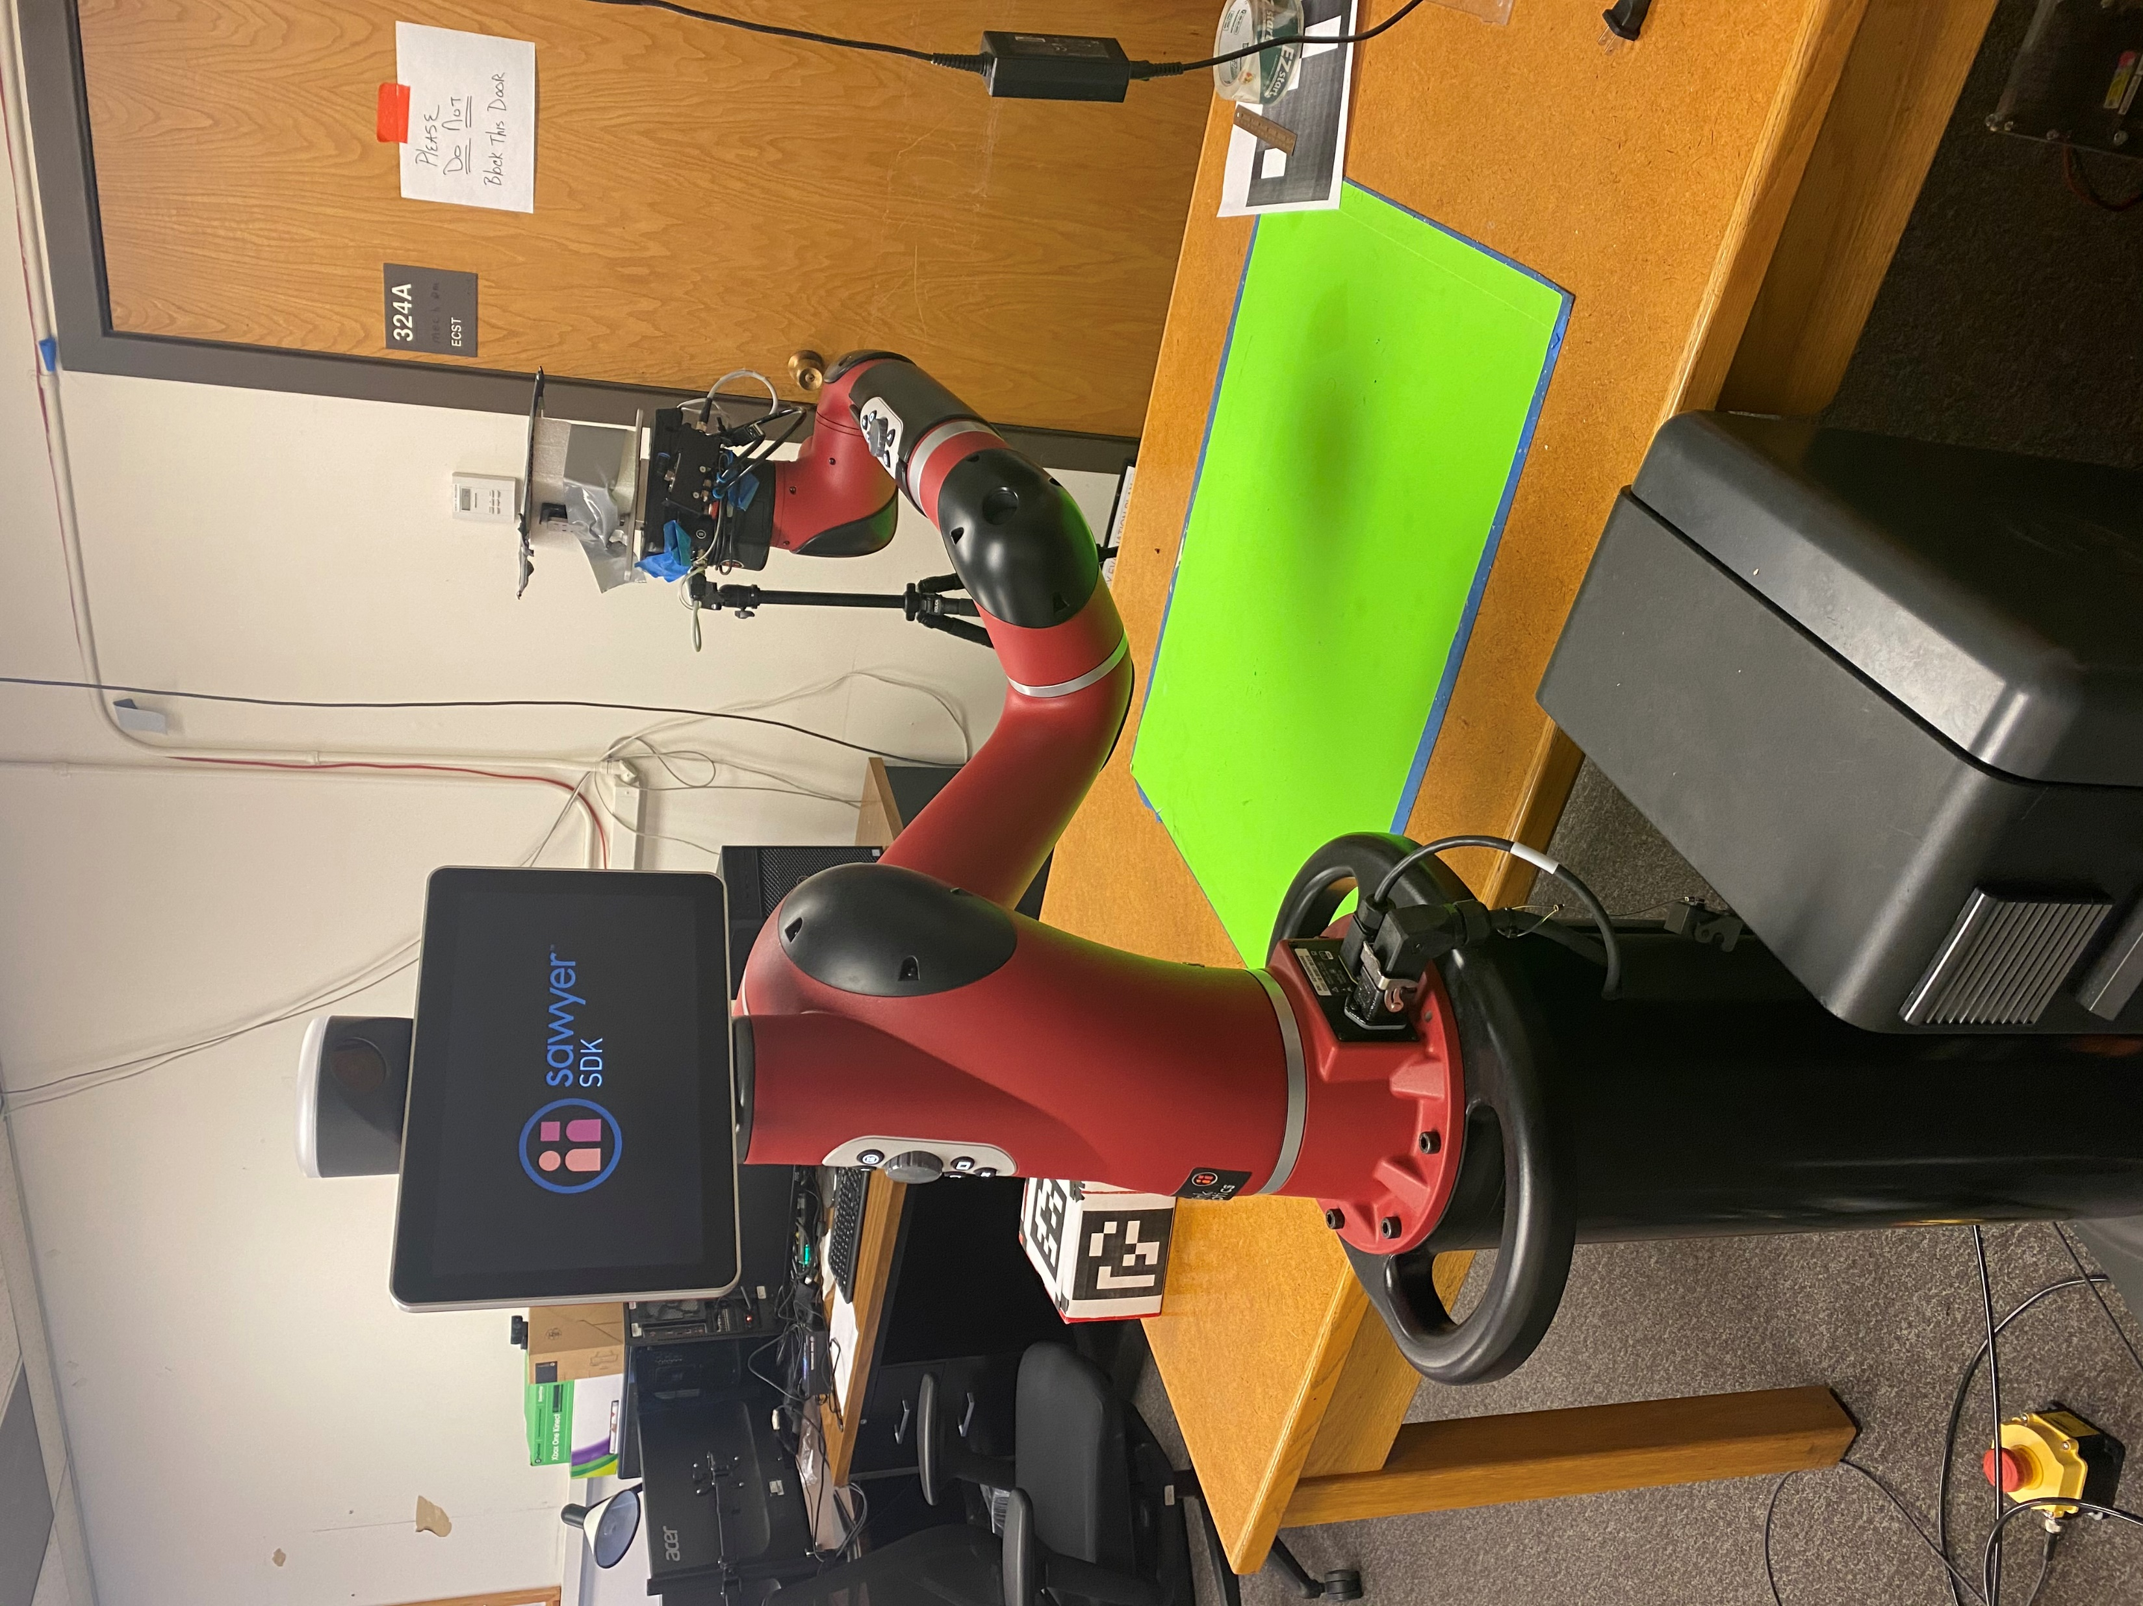
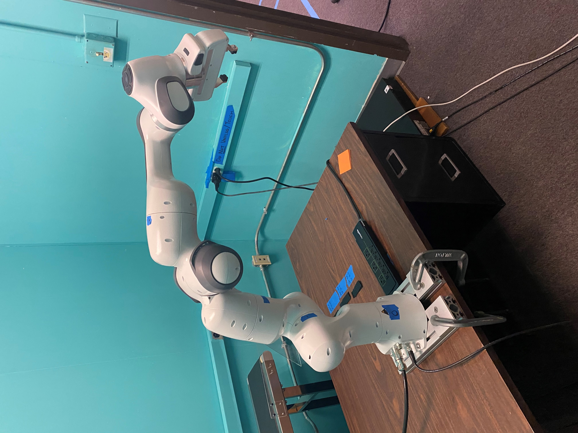
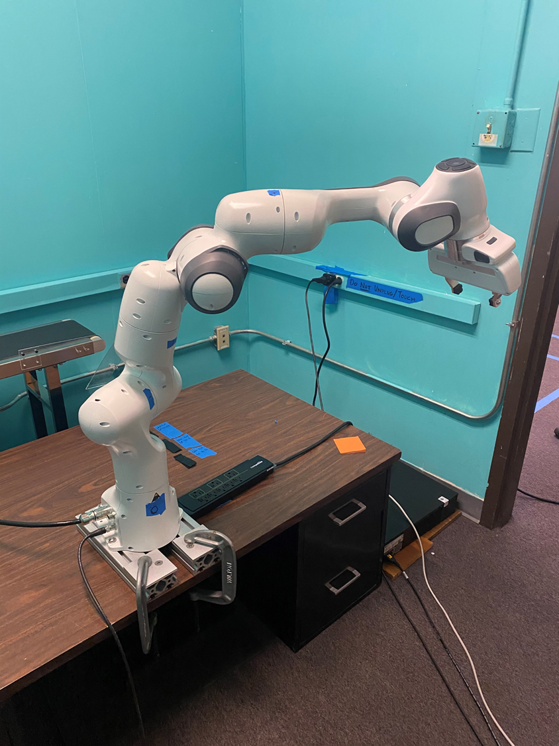
Future Direction
Implement with real sense to test with sawyer/panda (this semester)
Further research into accuracy discrepancy (potential next year)
Introduction | Methods | Evaluation | Method 2 | Evaluation 2 | Conclusion | Future

Slide 11
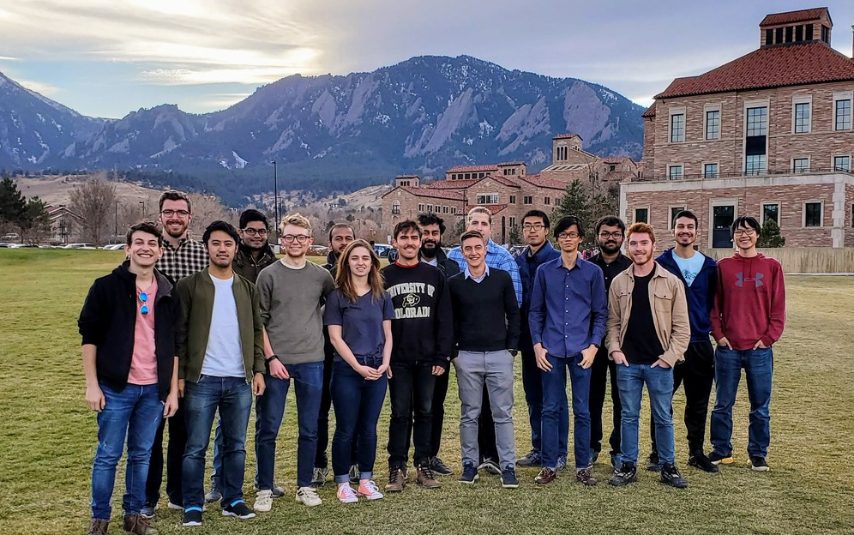
Acknowledgments
Alessandro Roncone
DLA Advisor and HIRO PI
Joewie Koh
Graduate Mentor of HIRO Lab
Liyang Ru
Peer and Co-worker of HIRO Lab
Barry Sparks
Manager at CU Boulder Recycling Operations Center
Pat Maguire
Electronics Engineer of Idea Forge
All the members of HIRO-Group

Slide 12
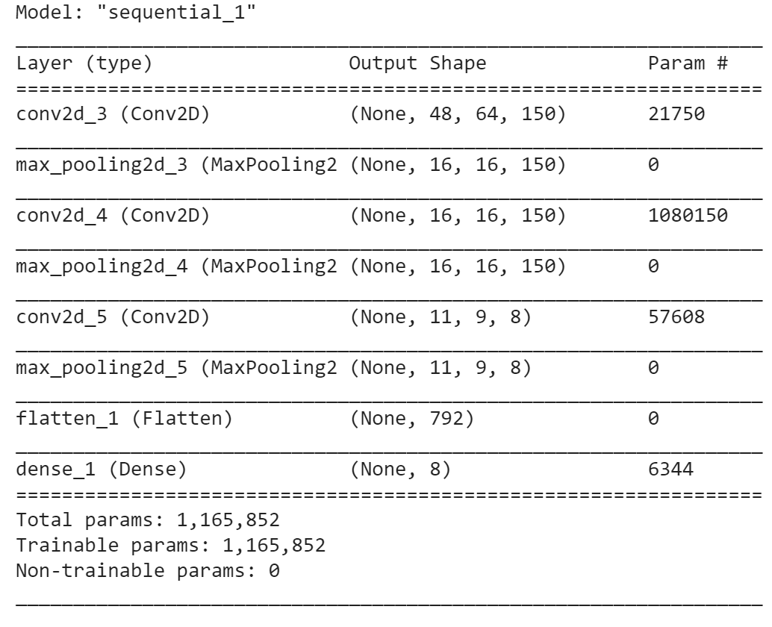
Appendix A: Model Summary

Slide 13
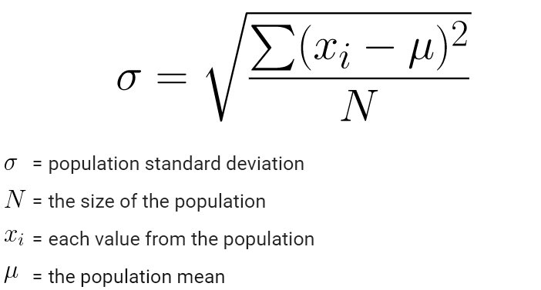
Appendix B: Extra Information
Confidence calculation performed by averaging the largest prediction values for each test image
Standard Deviation Formula:
Hyper Parameters used to optimize model: https://keras.io/
https://en.wikipedia.org/wiki/Standard_deviation

Slide 14
Appendix C: Full Code
https://colab.research.google.com/drive/1SaxHolDIznhrKT0n5qP2GuN9laOqdZps?authuser=1#scrollTo=7eExXpP0EODI

